Slide 1
Promoting Brain Health in the Workplace
Washington Wellness
February 26, 2020
Wellness Coordinator Training

Slide 2
Guest speakers
Lynne Korte, MPH
Dementia Care Program-Policy Analyst
Aging and Long Term Support Administration
WA State Department of Social and Health Services
Jamie Teuteberg, MS
Life Stages Coordinator
Clinical Quality and Care Transformation
WA State Health Care Authority
Maggie Christofferson, BASW
Education Coordinator
Alzheimer’s Association
Kim Concepcion
Wellness Coordinator
WA State Department of Health
Marci Getz, MPH
Director-Healthy Aging Initiatives
Center for Public Affairs
WA State Department of Health

Slide 3
Objectives
What is brain health
How brain health is impacting the workplace
What lifestyle interventions can improve brain health
What workplaces can do to support a “healthy brain” work environment

Slide 4
What are you looking forward to as you age?

Slide 5
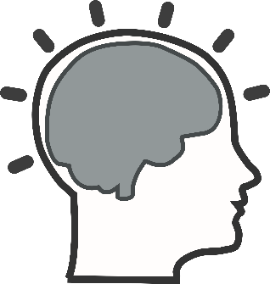
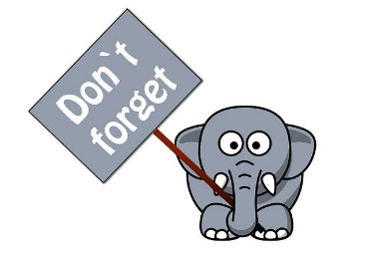
What is brain health?
Memory
______
Learning
______
Play
______
Concentration
______
Notes:
National Institute of Health definition:
Brain health refers to the ability to remember, learn, play, concentrate and maintain a clear, active mind. It’s being able to draw on the strengths of your brain – information management, logic, judgement, perspective and wisdom.
Simply, brain health is about making the most of your brain and helping reduce some risks to it as you age.

Slide 6
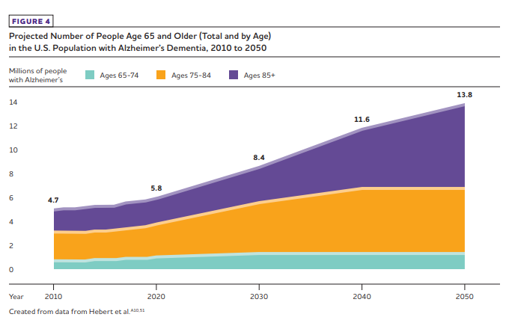
Prevalence of Alzheimer’s Dementia in the U.S.
Currently,
5.8 million people
Notes:
How we came to issue of brain health as an important issue for the state….
My role at DSHS-ALTSA over the years has been around helping people with dementia and family caregivers of people with dementia.
We’ve been tracking and serving people with dementia for a long time – its an issue that’s just more recently been recognized as a critical public health issue
That’s true both Globally and Nationally – (1) we’re living longer and (2) because of the aging of the baby-boomers – AGE WAVE
Combined with fact that the greatest RISK factor for Alzheimers is increasing age –
After age 65, the risk of AD doubles every 5 years
After age 85, risk is nearly one-third
But, IS NOT a certainty
The increase in older pop combined with increasing prevalence in older age groups told us we’d have increasing population with dementia
See slide
Nationally - An estimated 5.8 million Americans of all ages are living with Alzheimer’s dementia in 2019.
Of the 5.8 million people who have Alzheimer’s dementia,
81 percent are age 75 or older (Figure 1).A2,51 Out of the total U.S. population: •
One in 10 people (10 percent) age 65 and older has Alzheimer’s dementia.A3,51,157 •
The percentage of people with Alzheimer’s dementia increases with age: 3 percent of people age 65-74, 17 percent of people age 75-84, and 32 percent of people age 85 and older have Alzheimer’s dementia.51
From Alz Facts and Figures 2019– Alzheimer’s Association

Slide 7
Alzheimer’s disease is the 3rd leading cause of death in Washington, 6th leading cause in the U.S.
Notes:
Here’s how this plays out for Washington
AT ALTSA, we’ve been planning for the Age Wave (boomers aging)
the increase in pop combined with increasing prevalence in older age groups told us we’d have increasing population with dementia
See slide
CURRENTLY -
Alzheimer’s disease (AD) is 3rd leading cause of death
110,000 people currently living with Alzheimer’s Dementia
348,000 unpaid family caregivers
The number of Washingtonians diagnosed with this disease is projected to grow from 110,000 in 2019 to 140,000 in 2025,
which equals a 27.3% increase

Slide 8
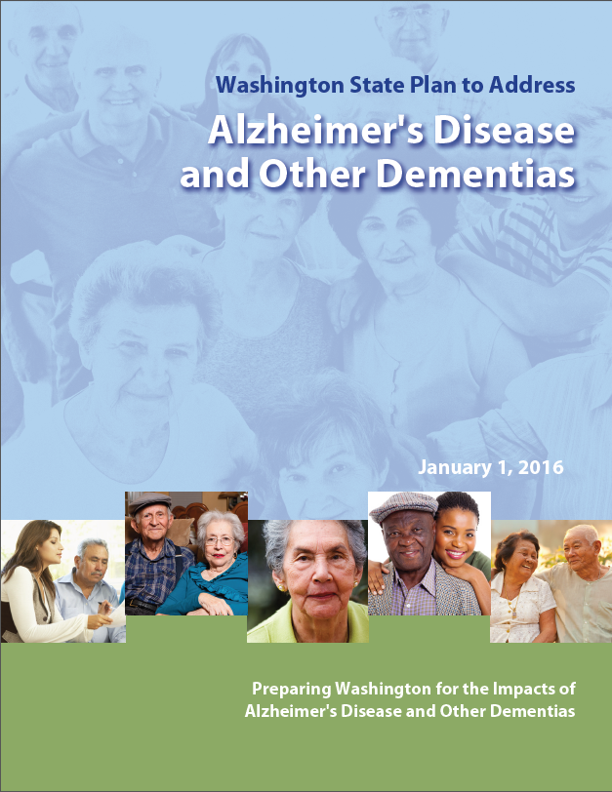
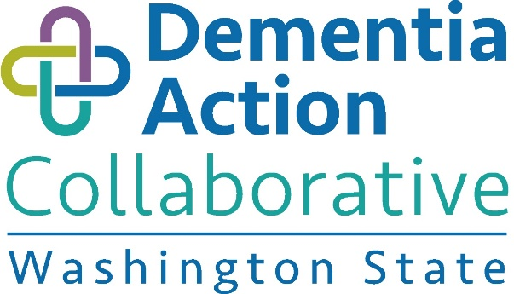
Strategy –
Increase public awareness about the connections between health and wellness, brain health and dementia.
Notes:
What are we doing about that?
In 2014 – Given the Age Wave, advocates pushed for a Governor’s Aging Summit
Recommendation was to develop a WA State Plan to Address Alzheimer’s and Other Dementias –
ADWG/Worked from 2014-2015 to convene broad stakeholder group to identify goals/strategies to address this increase
Published plan in early 2016 - 7 aspirational goals
Found strong interest of public, wanting to know about ways to PREVENT dementia –
AD – Is One of the MOST FEARED illnesses (and one of the most costly).
At time – clear Heart-brain connection. Heart health to brain health –
included STRATEGY around brain health/connections in the plan
Fortunately for us, this plan development came at a time of increasing interest nationally, and emerging evidence around brain health.

Slide 9
Dementia
Dementia
Dementia affects two or more of the following functions of the brain
Memory
Communication and language
Ability to focus and pay attention
Reasoning and judgment
Visual perception
Severe enough to interfere with daily life
Mixed dementia
Frontotemporal dementia
Dementia associated with Parkinson’s
Alzheimer’s disease
Vascular dementia
Lewy Body dementia
Alcohol-related dementia
Notes:
Before going further – want to step back for a moment and clarify
Dementia is not a “disease” itself – it is a general term that describes a set of symptoms caused by a variety of diseases or conditions.
Dementia is caused by damage to the brain that results in a decline in memory and intellect, severe enough to interfere with daily life
IMPORTANT TO KNOW (not on this slide)….Another condition that’s important, called MILD COGNITIVE IMPAIRMENT (changes serious enough to be noticed, but that don’t affect the ability to carry out everyday activities)
WHY is that important?
There are conditions that “look like dementia” but aren’t – situations where the cognitive impairment MIGHT be reversible – for example:
Medications with side effects impacting cognition and/or
Medication mis-use – (not taking correctly, or meds mixed with alcohol – that can cause confusion/impact way brain fxs)
Could be issues with thyroid, depression, excel use of alcohol, vitamin deficiencies…
This is one of the reasons that early detection is SO critical…
Effective supports can be put in place to help manage comorbidities before they lead to acute hospitalizations (Gestios, et al., 2012).
Early detection also serves as a gateway to other supportive interventions that positively impact an individual’s quality of life and care (Callahan, et al., 2006).

Slide 10
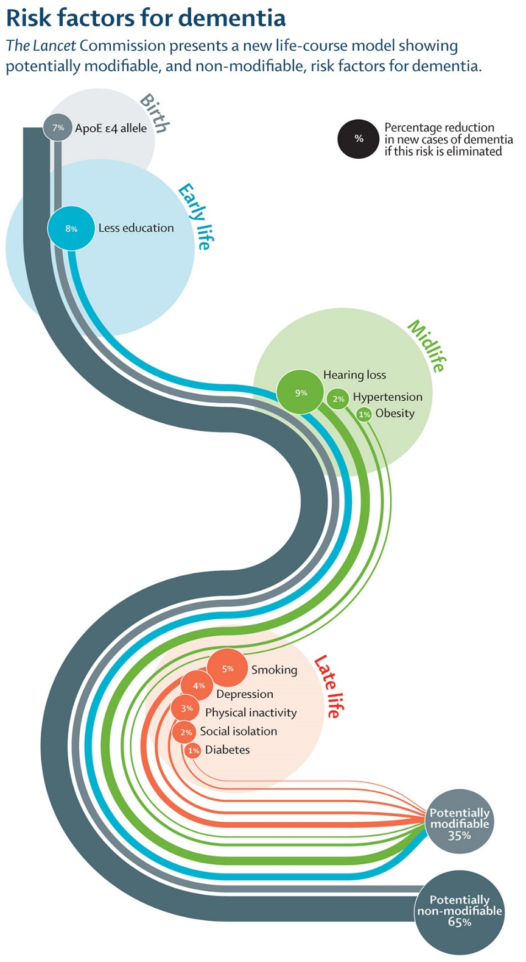
Reducing risk over the life-course
No cure or way to stop progression of Alzheimer’s disease
There are steps we can take to modify the experience
Lifestyle factors might reduce (or increase) a person’s risk for dementia
Midlife: hearing loss, hypertension, obesity
Late life: smoking, depression, physical activity, social isolation, diabetes
Notes:
Getting back now to the importance of brain health –
- While there is no cure for dementia – but there ARE THINGS we can do/STEPS we can take at any point to help people with suspected or diagnosed dementia
This includes in terms of reducing the risk for dementia over the life course
Into our first year – we were fortunate to find even more heightened interest in area of prevention/risk reduction, the Lancet Commission
Dementia prevention, intervention, and care
Gill Livingston, Andrew Sommerlad, Vasiliki Orgeta, Sergi G Costafreda, Jonathan Huntley, David Ames, Clive Ballard, Sube Banerjee, Alistair Burns, Jiska Cohen-Mansfield, Claudia Cooper, Nick Fox, Laura N Gitlin, Robert Howard, Helen C Kales, Eric B Larson, Karen Ritchie, Kenneth Rockwood, Elizabeth L Sampson, Quincy Samus, Lon S Schneider, Geir Selbæk, Linda Teri, Naaheed Mukadam; The Lancet, Vol. 390, No. 10113; Published: July 19, 2017; Full-Text HTMLPDF

Slide 11
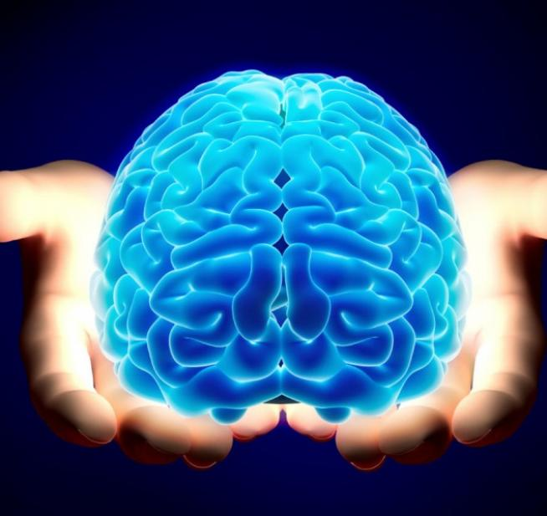
We are all aging
Good overall health may help to maintain good brain health
Optimize health
Optimize health care
Take Care!
Notes:
Not too young or too old to work towards healthy aging…
The brain is our most complex organ. It's also one of the most important. That's why trying to keep our brains healthy is critical now and as you age.
Do things we KNOW to be healthy
Stop doing things that are NOT healthy
Talking about AND with health providers not just about problems but about HOW to STAY well/healthy
CHANGES can help you feel more ‘brain healthy’ today and reduce risks in the future
LEADS us to the relationship between brain health, dementia and the workplace
Here to share more on this is Jamie Teuteberg/HCA
-----------------------------------------------------------------------------------------------------

Slide 12
Who is impacted by Alzheimer’s disease?
Notes:
Answer: Everyone!

Slide 13
How brain health impacts the workplace
Absenteeism
Productivity: Inattention or “brain fog”
Environmentally: Increased stress carried into the workplace
Economically: Turnover, early retirement (loss of information and expertise)

Slide 14
Caregivers in the workplace
Approximately 20% of the workforce provide care for older loved ones or those with disabilities and chronic conditions
Caregivers include all ages, races, and genders
About 60% are women, with an average age of 49
Spend an average of 24 hours a week providing care and support

Slide 15
Health impact of caregiving
Chronic stress.
Face emotional, physical, and financial challenges
Greater risk of developing chronic conditions
Higher incidence of diabetes

Slide 16
Age ranges: SmartHealth eligible employees
Notes:
Approximately 300, 000
Most common ages – 36-64
Prime ages for taking care of health concerns
Common age for family caregivers in the workplace –
important, because we have plenty of people who may have family members with AD/dementia which can have some significant impacts

Slide 17
Tips for family and care partners
Notes:
Video

Slide 18
Healthy Brain

Slide 19
Mission
To eliminate Alzheimer’s disease through the advancement of research; to provide and enhance care and support for all affected; and to reduce the risk of dementia through the promotion of brain health.

Slide 20
Vision
A world without Alzheimer’s disease®.

Slide 21
Caring for your brain in 4 areas
Physical Activity
Diet and Nutrition
Cognitive Stimulation
Social Engagement

Slide 22
Physical Activity

Slide 23
Here’s why we need to move:
The brain has over one billion neurons.
Heart beats roughly 120, 000 times.
25% of the blood flow goes to the brain.
What is good for our hearts is also good for our brains.

Slide 24
How can we increase our heart rate?
Walking Mowing the lawn
Running Walking the dog
Dancing Zumba
Gardening Kayaking
Yoga Hiking
Biking Rock Climbing
Housework Elliptical
Lifting weights Marching in Place
Swimming Playing with your kids

Slide 25
As long as your heart rate is up

Slide 26
Diet and Nutrition

Slide 27
Mediterranean Diet

Slide 28
Dash Diet

Slide 29
What to eat What to avoid
Nuts, seeds, legumes, beans, whole grains
Lean meats and fish
Fruits
Vegetables
Olive oil
Saturated and trans fats
Processed foods
Foods that are high in sodium and sugar
Deep fried foods
Unhealthy fast foods

Slide 30
Cognitive Stimulation

Slide 31
Ways to stimulate your brain
Learn a new language
Read
Learn a new skill
Learn a new game
Do word puzzles
Drive a new way home(no GPS)
Use your other hand to brush teeth/hair
Embrace new and novel experiences

Slide 32
Social Engagement

Slide 33
How to remain socially engaged
Visit friends
Visit family
Join a book club
Volunteer
Start a game night
Meet your neighbors
Say Hi at the grocery store
Try online dating
Go to social meet ups

Slide 34
Love your Brain

Slide 35
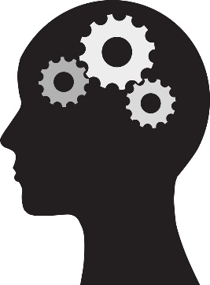
Promoting brain health in the workplace
______
______
______
______
Toolkit
Affinity Groups
Integration
Lifestyle
Notes:
Toolkit:
June is Alzheimer’s and Brain Health Awareness Month
Alzheimer’s Association’s 2020 toolkit available in May
SmartHealth activity tile
Affinity Groups:
Integration:
Lifestyle:

Slide 36
Affinity group: caring for working caregivers
Health Care Authority’s approach
Grassroots request
Forming
Purpose:
Provide resources to HCA caregiving employees
Shared experiences & understanding
Providing a better informed workplace

Slide 37
Additional support for caregivers in the workplace
Private area for phone calls
Flexible scheduling
Resource fairs
Remote work
Orientation materials offering caregiver information

Slide 38
Human resources support
Employee Assistance Program (EAP)
Family and Medical Leave Act (FMLA)
Paid Family and Medical Leave (PFML)
Special Leave: Family Care Emergencies

Slide 39
Integration: risk reduction messaging for health education
Exercise
Tobacco/Nicotine Use
Diabetes
High blood pressure
Obesity
Head injury
Notes:
Participants will have handout
Adjust the healthy behavior education to include facts and importance to the brain: People of any age can take actions to protect their heart and brain from disease.
Give examples

Slide 40
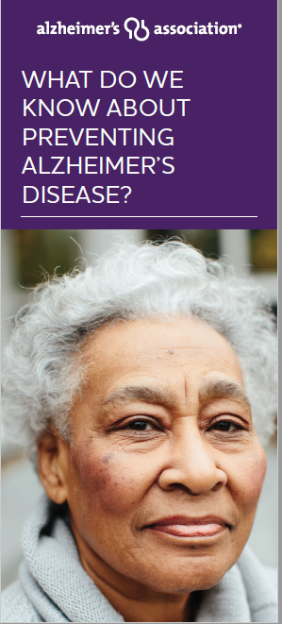
Healthy living for your brain: 10 Ways to Love Your Brain
Physical Activity
Diet and Nutrition
Cognitive Stimulation
Social Engagement
Notes:
Participants will have handout
Cross market brain related material such as “10 ways to love your Brain” in other events wellness orientations, health fairs, Immunizations, stretch breaks
Other examples”

Slide 41
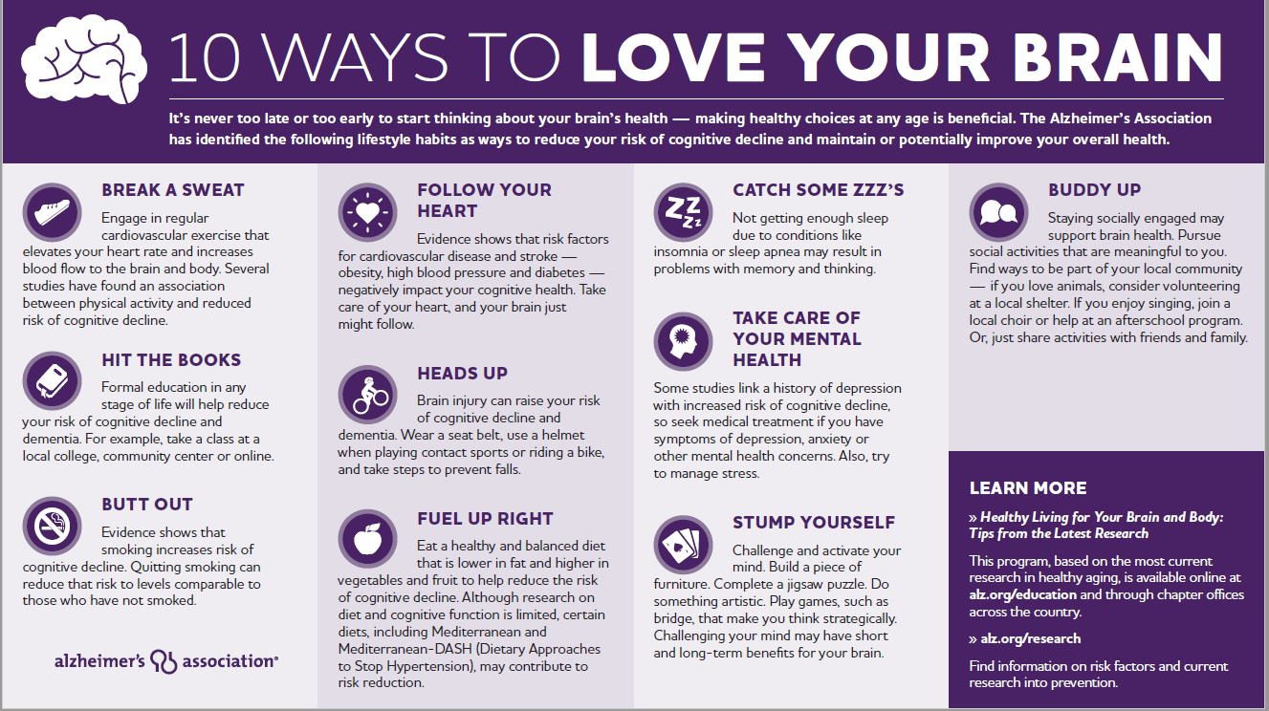

Slide 42
What else can wellness coordinators do?
Review policies that support people
Develop a policy in place to support social groups
Highlight SmartHealth tiles that support brain health
Offer group activities that encourage team options
Collaborate Combined Food Drive with wellness events
Include agency related or pop culture trivia in a newsletter
Notes:
State additional examples

Slide 43
Additional ideas?
What program ideas do you have that can support brain health ?
Please share you ideas in the room and on the webinar via text box.

Slide 44
Questions?
Please contact us at:
Washington Wellness
360-725-1700
wawellness@hca.wa.gov

