Slide 1
Apple Health Expansion Program
Legislative Briefing
July 18, 2023

Slide 2
Apple Health Expansion Program Overview
Overview of Benefits, Eligibility, and Privacy
Implementation Timeline
Eligibility Policy
Engagement with Advocates and Cross-Agency Coordination
Financial Overview
Next Steps

Slide 3
Apple Health Expansion Program
Overview of Benefits, Eligibility, and Privacy

Slide 4
Program Background
HCA was directed by the 2022 Operating Budget to model and begin expansion of Apple Health (AH) to immigrants who lack access to federal or state coverage programs.
Builds on years of coverage expansions and financial investments to reduce the state’s uninsured rate.
HCA modelling projected as many as 73,000 individuals could pursue enrollment in the program.
The 2023 Operating Budget provided funding for program administration and operational costs, directing enrollment to begin July 1, 2024.
Based on funding levels, HCA expects annual program enrollment to be capped.

Slide 5
Overview of Benefits & Eligibility
Eligibility requirements:
Adults over 19 with countable income up to 138% FPL.
Not eligible for other federally funded medical assistance programs or federal advanced premium tax credits through the individual market.
Mirror Federal programs to the extent possible. However, HCA will need to make some decisions when federal components are not applicable (example: pharmacy benefit and drug rebates).
HCA will develop rules for eligibility, enrollment processes, appeals procedures, and coverage for the programs prior to implementation.
Covered Services:
Medical, Behavioral Health, Dental, Transportation, Interpreter Services.
Does not include Long-Term Care.

Slide 6
Privacy
HCA, HBE, and DSHS will manage the same data privacy and protection standards utilized by existing Apple Health programs to ensure clients’ identity and information remain confidential.
HCA is required under federal and state law, including under HIPAA, to maintain the privacy of its client’s information.
For example, some data is subject to the Keep Washington Working Act.
Once eligibility for an AH program is established, a client’s immigration status is not shared on our external facing portals, to the client and their providers it looks like any other AH coverage.
Individuals who do not have an immigration status do not have any of their information shared with the federal hub or SAVE.

Slide 7
Apple Health Expansion Program
Implementation Timeline

Slide 8
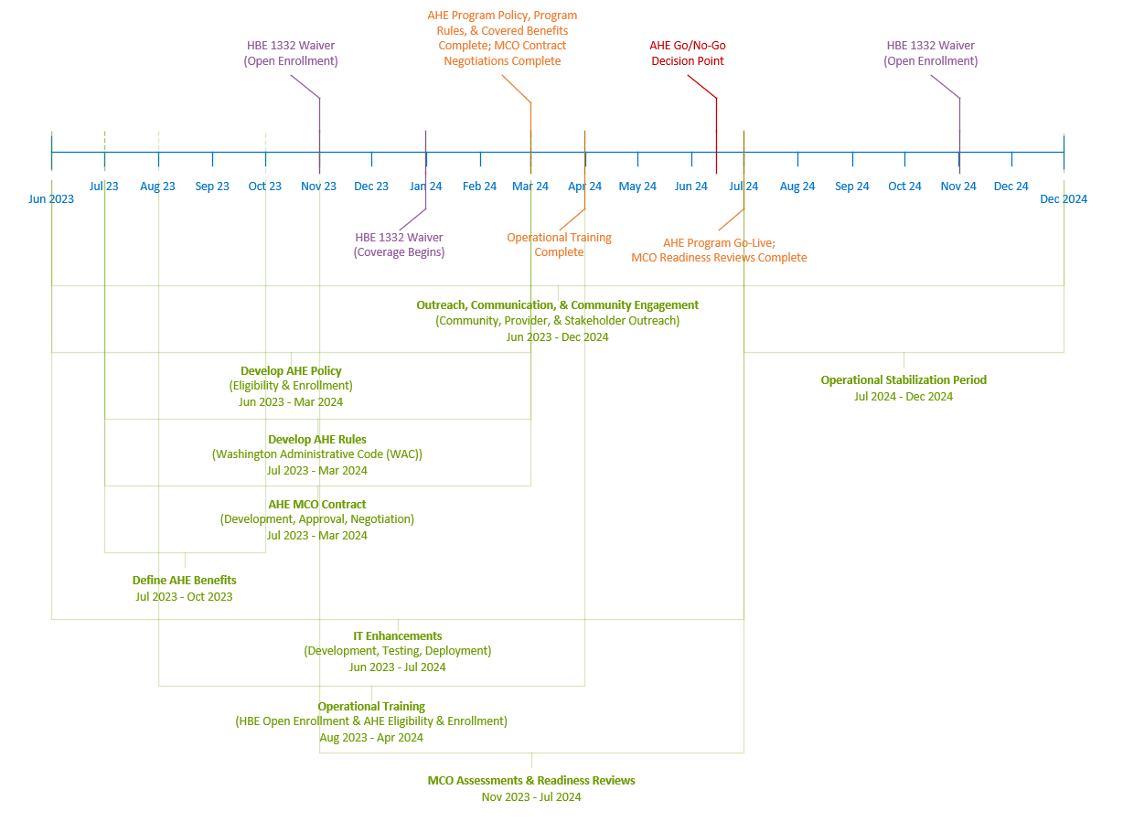

Slide 9
Apple Health Expansion Program
Eligibility Policy

Slide 10
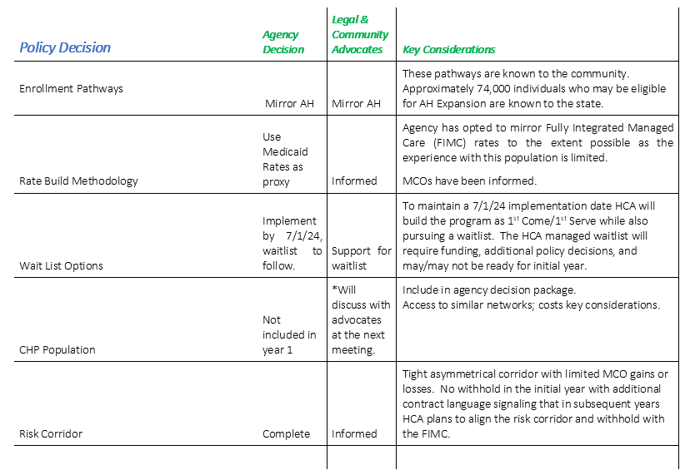

Slide 11
Enrollment Scenarios
The following enrollment scenarios outline how HCA could manage enrollment for known and new populations.
Major considerations:
Minimizing client burden
Managing complexity of capped program
Managing transitions from other AH programs or a QHP
Wait list
Community feedback
Protecting the privacy of individuals participating in AH programs

Slide 12
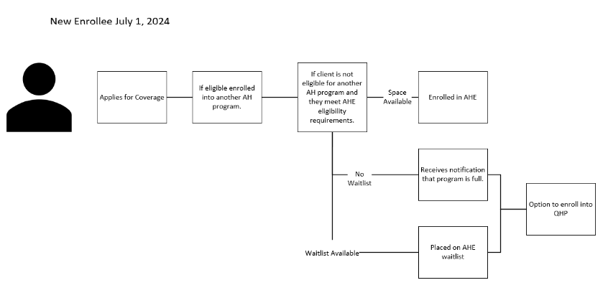

Slide 13
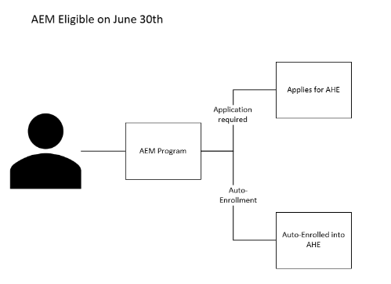

Slide 14
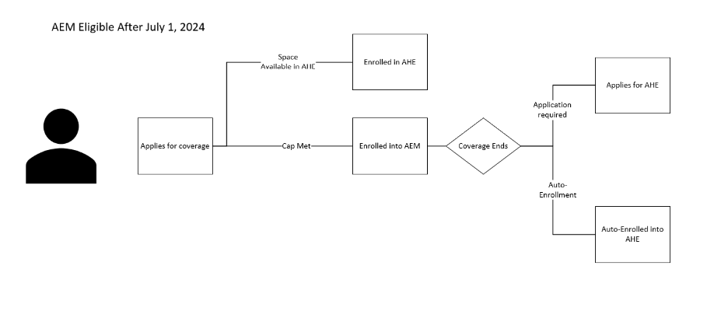

Slide 15
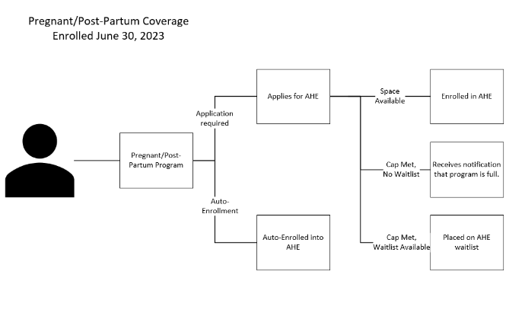

Slide 16
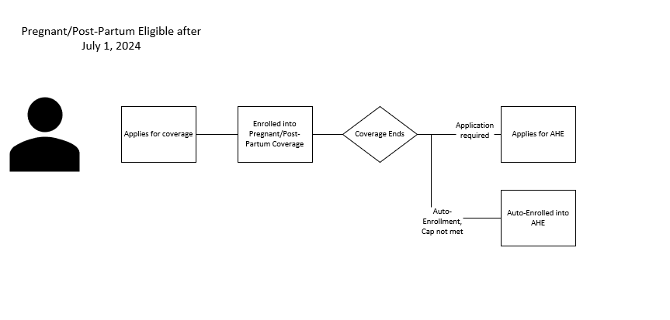

Slide 17
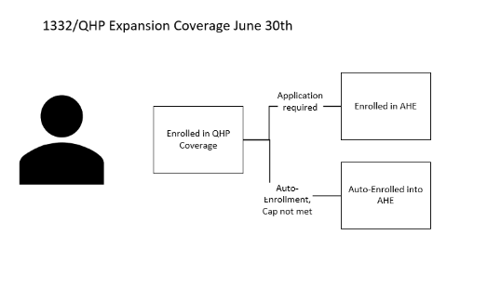

Slide 19
Apple Health Expansion Program
Coordination across agencies
& Community Engagement

Slide 20
Cross-Agency Collaboration
Community Outreach
Apple Health Expansion- Bi-Weekly Advocate Meetings
Leaders, subject matter experts from across the agencies to discuss/address agenda topics.
HBE’s landscape scan activities
HCA & HBE leveraging data from HBE’s contractor, The Vida Agency, to help inform communication and outreach activities.
Operations
Cross-agency Monthly Check-In
Leaders from across agencies to discuss implementation progress, and risks or issues that have a cross-agency impact.
Operational Meetings (weekly)
Subject matter experts to ensure eligibility/enrollment IT builds are progressing

Slide 21
Advocate & Community Engagement
Bi-weekly AH Expansion Advocate Meetings
Discuss 1332 and AH Expansion Implementation
Seek feedback/input to the process
Transitioning to a temporary Community Engagement Advisory Committee
Expanding meeting to include Community Based Organizations and other organizations who are working directly with impacted communities.
Provide structure for feedback on key policy areas prior to implementation of both programs. For example, the state will identify the type of feedback needed (consult, involve, collaborate, empower).
Temporary community engagement steering committee would help set up the Apple Health Community Engagement Committee. Draft committee makeup: 10 CBOs, 2-3 legal advocates, and 1-2 representatives from each agency.

Slide 22
Community Engagement Committee
The Community Engagement Committee is designed to provide the agency with feedback and input on the AH Expansion program, with a special emphasis on outreach and education activities.
Draft framework of committee:
Five (5) individuals representing members/clients of the new AH Expansion program;
Five (5) community-based organizations that are led by and serve the target population;
Three (3) advocates familiar with the medical needs of low-income population groups and with the resources available and required for their care;
Five (5) health care providers or health systems experts who have experience working with the target population;
Representatives from each managed care organizations who hold contracts with HCA to serve the target population; and
Representatives from HBE and DSHS

Slide 23
Apple Health Expansion Program
Financial

Slide 24
MCO Financial Package
Rate Approach:
General - Mirror Fully Integrated Managed Care (FIMC) rates to the extent possible with some technical differences
Pharmacy – ArrayRX to set PDL (similar to the Uniform Medical Plan PDL) will also include over the counter drugs included in the FIMC pharmacy benefit.
Risk Corridor:
Goals -
Reflect general uncertainty about cost and utilization in initial years of the program
Mitigate risk for both the state and MCOs
Plan - Tight in initial years with long-term goal of aligning with FIMC
Withhold:
Plan- include withhold structure similar to FIMC in contract with zero weighted measures in initial year. Long-term goal of aligning with FIMC

Slide 25
Apple Health Expansion Program
Next Steps

Slide 26
Next Steps
Coordinated outreach efforts ahead of HBE’s open enrollment.
Continued collaboration across agencies to ensure 7/1/24 implementation date.
Submission of agency decision packages (HCA, HBE, and DSHS):
Community Outreach & Education
FTE requests
Waitlist dollars and other systems changes
EQRO contract
CHP transition funding
Case manager for non-MAGI case load (enrollment pathways issue paper)
Array RX dollars

Slide 27
Questions
Becky Carrell MPD Deputy Division Director rebecca.carrell@hca.wa.gov 360-972-0347
Catrina Lucero
Deputy CFO
Catrina.Lucero@hca.wa.gov

